Slide 1
Lecture 13: Fitting spatial + space-time models
Eric Ward
Feb 17 2015

Slide 2
What we’ve learned so far
Time series can be useful for identifying structure, improving precision, and accuracy of forecasts
Modeling multivariate time series
e.g. MARSS() function, with each observed time series mapped to a single discrete state
Using DFA
Structure determined by factor loadings

Slide 3
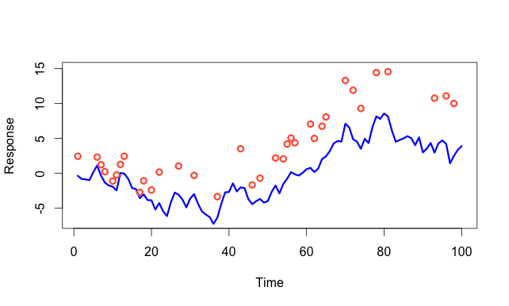
Response generally the same variable (not separate species)
Making inference about population as a whole involves modeling
pink as well as blue time series
Notes:
y = cumsum(rnorm(100))
plot(y, type="l",col="blue1",lwd=3,ylim=c(-7,15),ylab="Response", xlab= "Time")
y2 = y + 5 + rnorm(length(y),0,1)
y2[sample(seq(1,length(y2)),size=65,replace=F)]=NA
points(y2,col="tomato1",lwd=3)

Slide 4
Multivariate approach with MARSS
Time series modeled as independent (allowed to have different states/trends)
But we estimate the correlation with Q matrix
Q = “unconstrained”
Obvious problem: (m * (m+1))/2 parameters!

Slide 5
Constraints on constraints
We’d like to be able to reduce # parameters in Q matrix, and can specify alternate structures, but we have to follow rules
This can cause problems in MARSS
If (1,2) are correlated and (2,3) correlated, (1,3) have to be correlated

Slide 6
Multivariate approach with DFA
Estimate how individual observed time series load onto ‘trends’

Slide 7
Potential problems with both the MARSS and DFA approach
Sites separated by large distances
may be grouped together
Sites close to one another may be
found to have very different dynamics

Slide 8
Are there biological mechanisms that may explain this?
Puget Sound Chinook salmon
21 populations generally cluster into 2-3 groups based on genetics
Historically large hatchery programs
Hood canal harbor seals
Visited by killer whales

Slide 9
Motivation of explicitly including spatial structure
Adjacent sites can be allowed
to covary
Estimated parameters greatly
reduced to 2-5

Slide 10
Types of spatial data
Point referenced data
Aka geostatistical data
Typically 2-D, but could be 1-D or 3-D (depth, altitude)
May be fixed station or random (e.g. trawl surveys)
Point pattern data
Spatially referenced based on outcomes
Presence of a species
Inference focused on describing clustering (or not)
Areal data
Locations occur in blocks
counties, management zones, etc.

Slide 11
Computationally convenient approaches
CAR (conditionally autoregressive models)
Better suited for Bayesian methods
Goal of both is to write the distribution of a single prediction analytically in terms of the joint (y1, y2)
SAR (simultaneous autregressive models)
Better suited for ML methods
Simultaneously model distribution of predicted values
‘Autoregressive’ in the sense of spatial dependencey / correlation between locations

Slide 12
CAR models (Besag 1991)
Create spatial adjacency matrix W, based on neighbors, e.g.
W(i,j) = 1 if neighbors, 0 otherwise
W often row-normalized (rows sum to 1)
Regression coefficients
Spatial component (aka Markov Random Field)
Residual error term

Slide 13
1
 | 1 | 2 | 3 | 4 | 5
1 | 0 | 1 | 0 | 0 | 0
2 | 1 | 0 | 1 | 0 | 0
3 | 0 | 1 | 0 | 1 | 0
4 | 0 | 0 | 1 | 0 | 1
5 | 0 | 0 | 0 | 1 | 0
2
3
4
5

Slide 14
Besag et al. 1991
Leroux et al. 1999
In matrix form
Implemented in R: spdep, CARBayes

Slide 15
SAR models
Simultaneous autoregressive model
Remember that the CAR was

Slide 16
Commonalities of both approaches
Adjacency matrix W can also instead be modified to include distance
Models spatial dependency as a function of single parameter ρ
Models don’t include time dimension in spatial field
One field estimated for all time steps

Slide 17
Problems with these approaches
Wall (2004) “A close look at the spatial structure implied by the CAR and SAR models”

Slide 18
Alternative to CAR & SAR: model elements of Q as functions
Create matrix D, as pairwise distances
This can be 1-D, or any dimension
We’ll use Euclidian distances for 2-D
1
2
3
4
5

Slide 19
Next specify spatial covariance function (aka “kernel”)
Exponential
Squared exponential*
Matern family
*Also referred to as radial basis function, or Gaussian

Slide 20
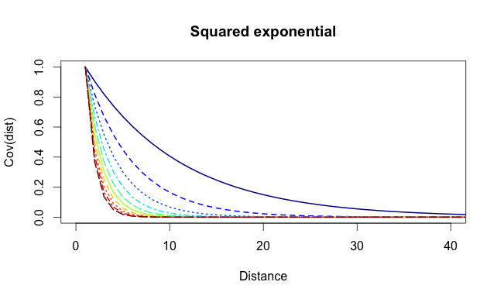
Θ=10
Θ=1
Notes:
library(fields)
theta = 1
x = seq(0,99)
mat = matrix(0, 100, 10)
for(i in 1:10) {
mat[,i] = exp(-(i/10)*x)
}
matplot(mat,type="l",col=tim.colors(10),lwd=2,xlim=c(0,40),ylab="Cov(dist)",xlab="Distance",main="Squared exponential")

Slide 21
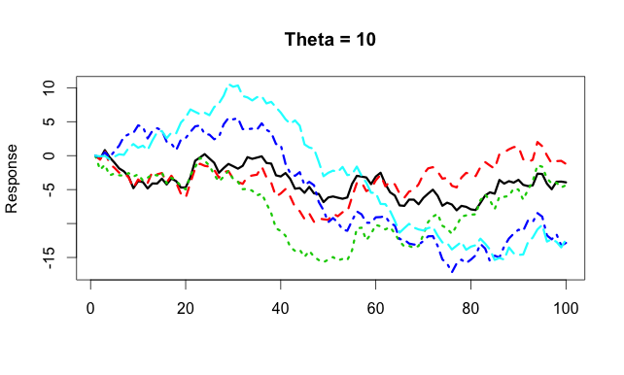
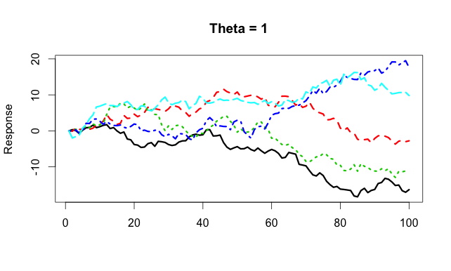

Slide 22
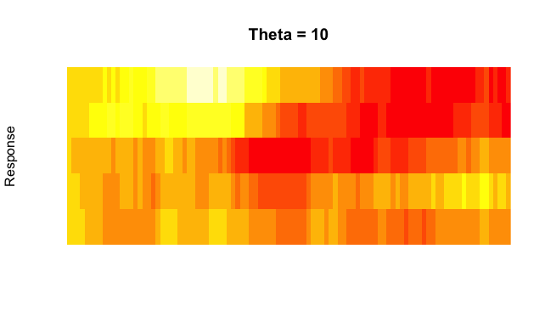
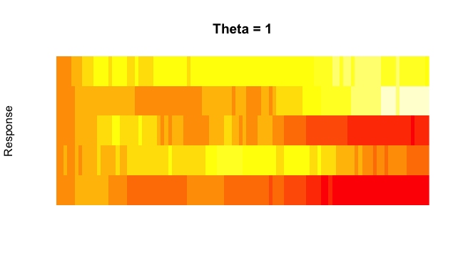

Slide 23
Considerations for time series models
Should spatial dependency be included
How to model it
Constant
Time varying
Autoregressive
Random walk
Independent variation?

Slide 24
Model-based geostatistical approaches
1. Generalized least squares
2. Bayesian methods in spBayes
3. INLA models
4. Writing your own Bayesian code

Slide 25
Method 1: using gls()
Generalized least squares function
Similar syntax to lm, glm, etc.
Flexible correlation structures
corExp()
corGaus()
corLin()
corSpher()
Allows irregularly spaced data / NAs
unlike Arima(), auto.arima(), etc.

Slide 27
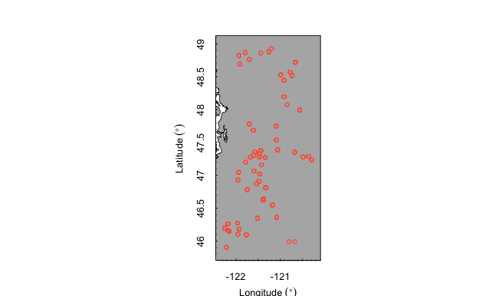
We’ll use Snow Water Equivalent
(SWE) data in Washington state
70 SNOTEL sites
We’ll focus only on Cascades
1981-2013
Initially start using just the February SWE data
1518 data points (only 29 missing values!)

Slide 28
We can use AIC to evaluate different correlation structures
mod.exp = gls(Feb ~ elev, correlation = corExp(form=~lat+lon,nugget=T), data = y[which(is.na(y$Feb)==F & y$Water.Year==2013),])
AIC(mod.exp) = 431.097
mod.gaus = gls(Feb ~ elev, correlation = corGaus(form=~lat+lon,nugget=T), data = y[which(is.na(y$Feb)==F & y$Water.Year==2013),])
AIC(mod.gaus) = 433.485

Slide 29
Diagnostics: fitting variograms
var.exp <- Variogram(mod.exp, form =~ lat+lon)
plot(var.exp,main="Exponential",ylim=c(0,1))
var.gaus <- Variogram(mod.gaus, form =~ lat+lon)
plot(var.gaus,main="Gaussian",ylim=c(0,1))

Slide 30
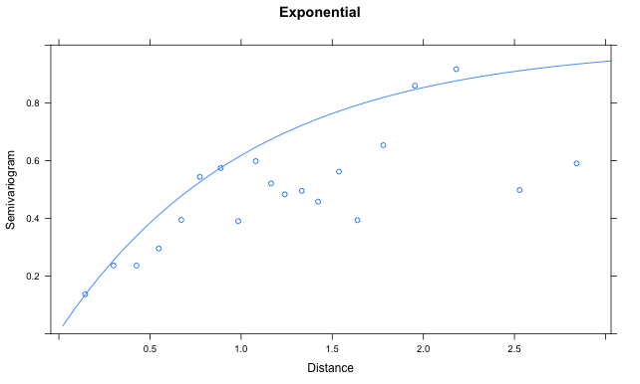
Exponential variogram
Sill
No correlation
More variation
Nugget
Range

Slide 31
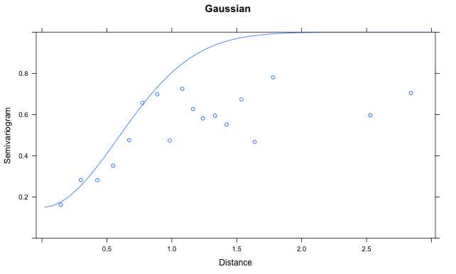
Gaussian variogram

Slide 32
Extensions of these models
corExp and corGaus spatial structure useful for wide variety of models / R packages
Linear/non-linear mixed effect models
lme() / nlme() in nlme package
Generalized linear mixed models
glmmPQL() in MASS package
Generalized additive mixed models
gamm() in mgcv package

Slide 33
Method 2: spBayes
Slightly more complicated syntax:
Specify:
a. Priors on parameters
b. Tuning parameters for Metropolis sampling (jumping variance)
c. Starting / initial values
d. Covariance structure (“exponential”, “gaussian”, “matern”, etc)
e. Number of MCMC iterations / burn-in, etc.

Slide 34
Example with WA SWE data
# This syntax is dependent on model parameters. See vignette
priors <- list("beta.Norm"=list(rep(0,p), diag(1000,p)), "phi.Unif"=c(3/1, 3/0.1), "sigma.sq.IG"=c(2, 2), "tau.sq.IG"=c(2, 0.1))
# Phi is spatial scale parameter, sigma.sq is spatial variance, tau.sq = residual
starting <- list("phi"=3/0.5, "sigma.sq"=50, "tau.sq"=1)
# variance of normal proposals for Metropolis algorithm
tuning <- list("phi"=0.1, "sigma.sq"=0.1, "tau.sq"=0.1)
m.1 <- spLM(y~X-1, coords=cords,n.samples=10000, cov.model = "exponential", priors=priors, tuning=tuning, starting=starting)

Slide 35
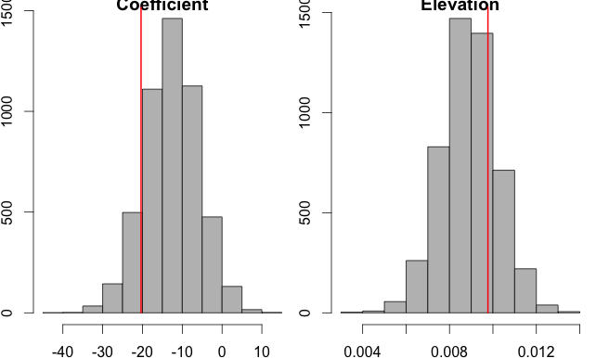
Coefficients need to be extracted
##recover beta and spatial random effects
burn.in <- 5000
m.1 <- spRecover(m.1, start=burn.in, verbose=FALSE)

Slide 36
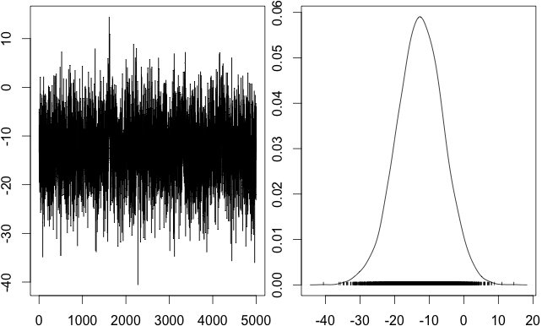
Standard MCMC diagnostics
Output is of class ‘mcmc’

Slide 37
Other spatial models in spBayes
Non-Gaussian errors
spGLM
Multivariate
spMvLM()
spMvGLM()
Dynamic linear model (DLM)
spDynLM

Slide 38
Method 3: models in INLA
INLA = Integrated Nested Laplace Approximation
R-INLA software = interface between R and the GMRFLib C library, etc.
Get it here:
http://www.r-inla.org/

Slide 39
Motivation of INLA
Some problems contain simple spatial structure
e.g. the harbor seal data in MARSS() with only 5 – 7 time series
Others are much more complex
WA SWE data
Fisheries survey data (1000s of points)
Including time-varying spatial fields becomes very computationally difficult
Doing all of the above in a Bayesian setting can be prohibitive, but we can use Laplace approximation

Slide 40
Varying spatial fields example: eulachon-shrimp bycatch

Slide 41
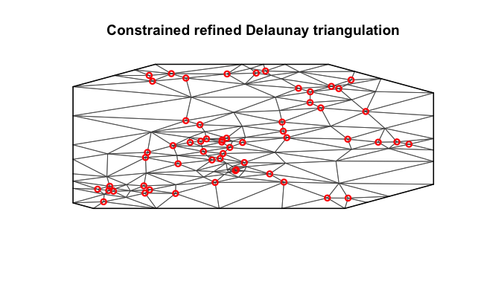
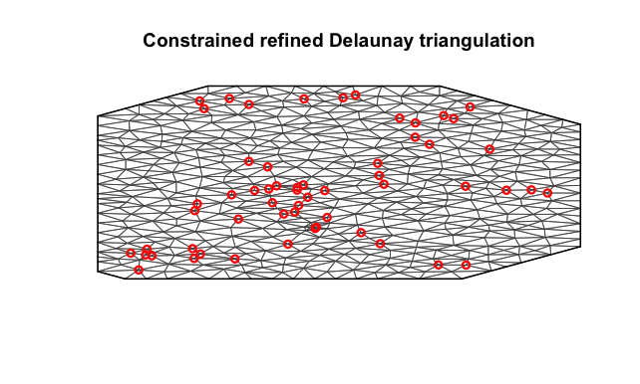
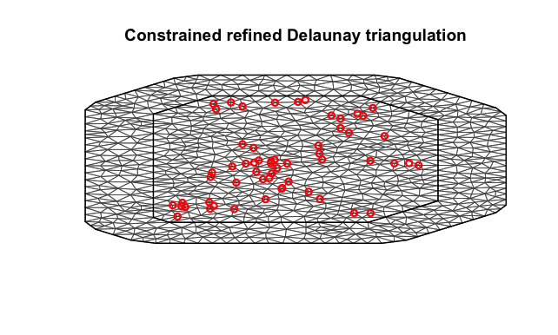
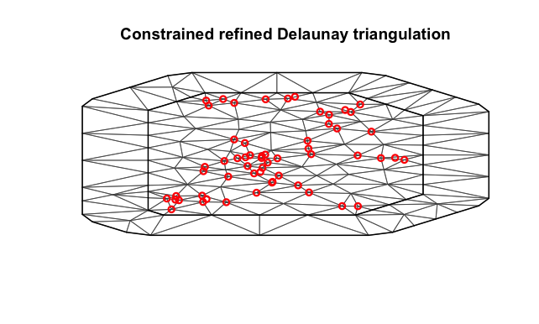
INLA’s approximation: SNOTEL data
How many points fall on vertices? Is the boundary area large enough? Choosing
this must be done very carefully!

Slide 42
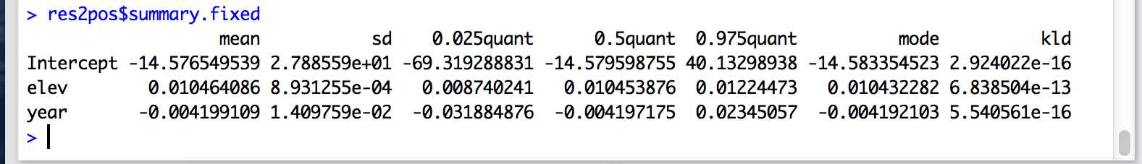
Estimation done via maximum likelihood
Estimates seems similar to those from gls()
and spBayes()
Year included as numeric here (not significant)
Alternatively, we can include year in spatial field
Year can also be included as factor

Slide 43
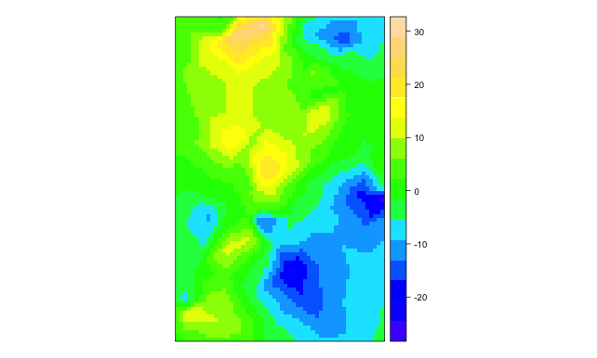
Projecting INLA estimates to surface

Slide 44
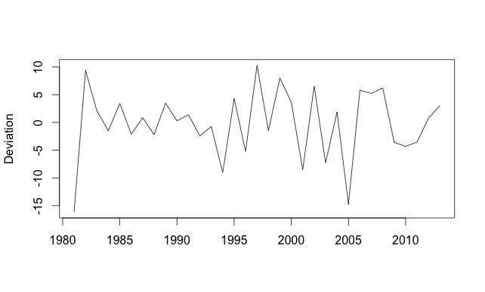
Fixed effect (factor) estimates

Slide 45
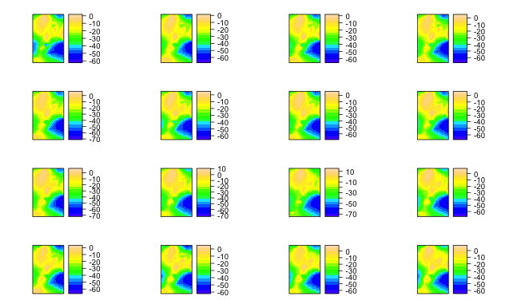
Spatial SWE fields by year

Slide 46
Additional output / diagnostics
Plots of observed v fitted values
Prediction to new locations
Samples from posterior distribution via Laplace approximation

Slide 47
Method 4: writing models ourselves in JAGS
Remember spatial effects = random effects
Previous approaches we’ve seen so far:
Estimate Q matrix as
diagonal (populations independent) or
unconstrained (correlated, but not including space)
e.g.
z[1:m] ~ dmnorm(0, invSigma[1:m,1:m])

Slide 48
Modification for spatial model (gaussian)
1. Create distance matrix D, and include that in your ‘data’ list you pass to JAGS
D2 = dist(coords, upper = T, diag = T)^2
2. Model elements of Sigma directly
for(i in 1:m) {
for(j in 1:m) {
Sigma[i,j] <- sigma2 * exp(-theta*D2[i,j]);
}
}
invSigma[1:m,1:m] <- inverse(Sigma[1:m,1:m]);
- unfortunately, no way to work around loops

Slide 49
How do we want to model random effects?
Constant
z[1:m] ~ dmnorm(0, invSigma[,])
Time varying and independent
for(i in 1:t) {
z[1:m,i] ~ dmnorm(0, invSigma[,])
}
Autoregressive
z[1:m,1] ~ dmnorm(0, invSigma[,])
for(i in 2:t) {
z[1:m,i] ~ dmnorm(z[1:m,i-1] , invSigma[,])
}

Slide 50
Examples of recent NOAA work
Ward, E.J., G.R. Pess, K. Anlauf-Dunn, and C.E. Jordan. 2012. Applying time series models with spatial correlation to identify the scale of variation in habitat metrics related to threatened coho salmon (Oncorhynchus kisutch) in the Pacific Northwest. Canadian Journal of Fisheries and Aquatic Sciences, 69(11): 1773-1782
Shelton, A.O., J.T. Thorson, E.J. Ward, and B.E. Feist. 2014. Spatial, semi-parametric models improve estimates of species abundance and distribution. Canadian Journal of Fisheries and Aquatic Sciences, 71: 1655-1666
Thorson, J.T., H. Skaug, K. Kristensen, A.O. Shelton, E.J. Ward, J. Harms, and J. Benante. 2015. The importance of spatial models for estimating the type and strength of density dependence. Ecology, In press
Ward, E.J., K.N. Marshall, A. Sedgley, T. Ross, T. Hass, S.F. Pearson, G. Joyce, N.J. Hamel, P.J. Hodum, R. Faucett. 2015. Using citizen-science data to identify local hotspots of seabird occurrence. PeerJ 2:e704
Ward, E.J., J.H. Anderson, T.J. Beechie, G.R. Pess, and M.J. Ford. 2015. Increasing hydrologic variability threatens depleted anadromous fish populations. In press, Global Change Biology

